Slide 1

Optimal Moving Average Estimation of Noisy Random Walks using Allan Variance-informed Window Length
Hossein Haeri¹, Behrad Soleimani², and Kshitij Jerath¹
¹ Department of Mechanical Engineering, University of Massachusetts Lowell
² Department of Electrical and Computer Engineering, University of Maryland
American Control Conference (ACC2022)
June 8, 2022 | Atlanta, GA

Slide 2
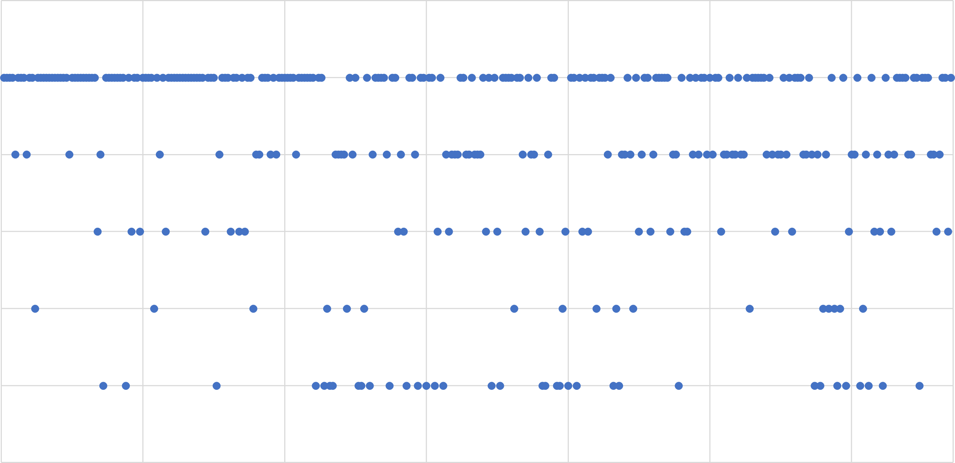
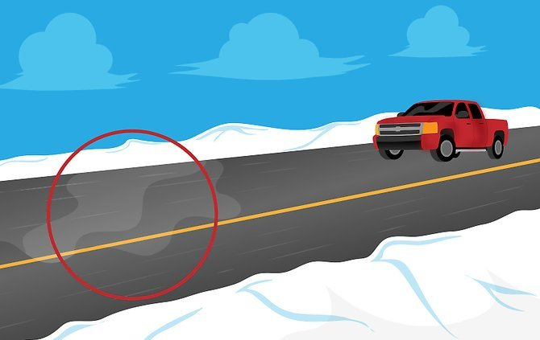
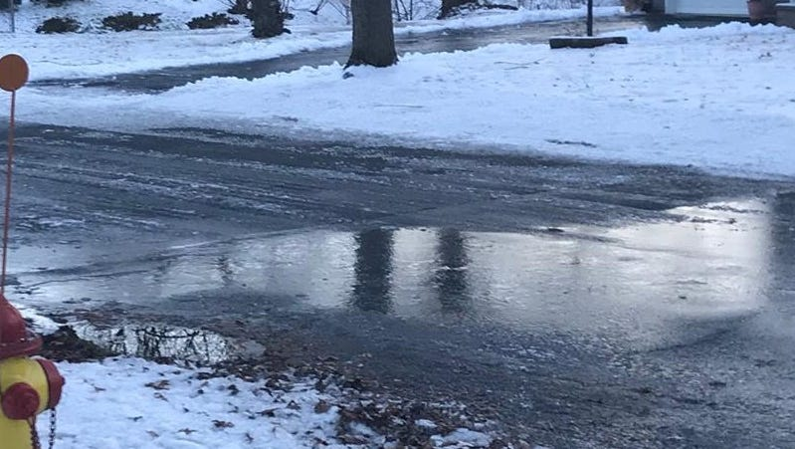
Is Your Data Still Relevant?
Problem:
Estimating drifting parameters
using noisy data.
Main motivation:
Estimating roadway friction using
noisy vehicular measurements.
5
Data¹
4
3
Current time plane
2
1
Time
Black ice in Parisippany - Photo by William Westhoven, 2018
[1] Data represents customer rating of a particular product on Amazon (https://nijianmo.github.io/amazon/index.html)
Notes:
Let’s consider the user ratings of a certain product on Amazon
We want to estimate the current quality of the product, but we know not all the ratings have the same value.
In fact, the product used to receive good ratings initially, but after some time it got some bad ratings indicating that the quality of the product might have gone bad.
The question is if we want to build a model for predicting the current quality of the product, what portion of the data should be used to train that model with?

Slide 3
Is Your Data Still Relevant?
5
Data¹
4
3
Current time plane
2
1
Time
[1] Data represents customer rating of a particular product on Amazon (https://nijianmo.github.io/amazon/index.html)
Notes:
Let’s consider the user ratings of a certain product on Amazon
We want to estimate the current quality of the product, but we know not all the ratings have the same value.
In fact, the product used to receive good ratings initially, but after some time it got some bad ratings indicating that the quality of the product might have gone bad.
The question is if we want to build a model for predicting the current quality of the product, what portion of the data should be used to train that model with?

Slide 4
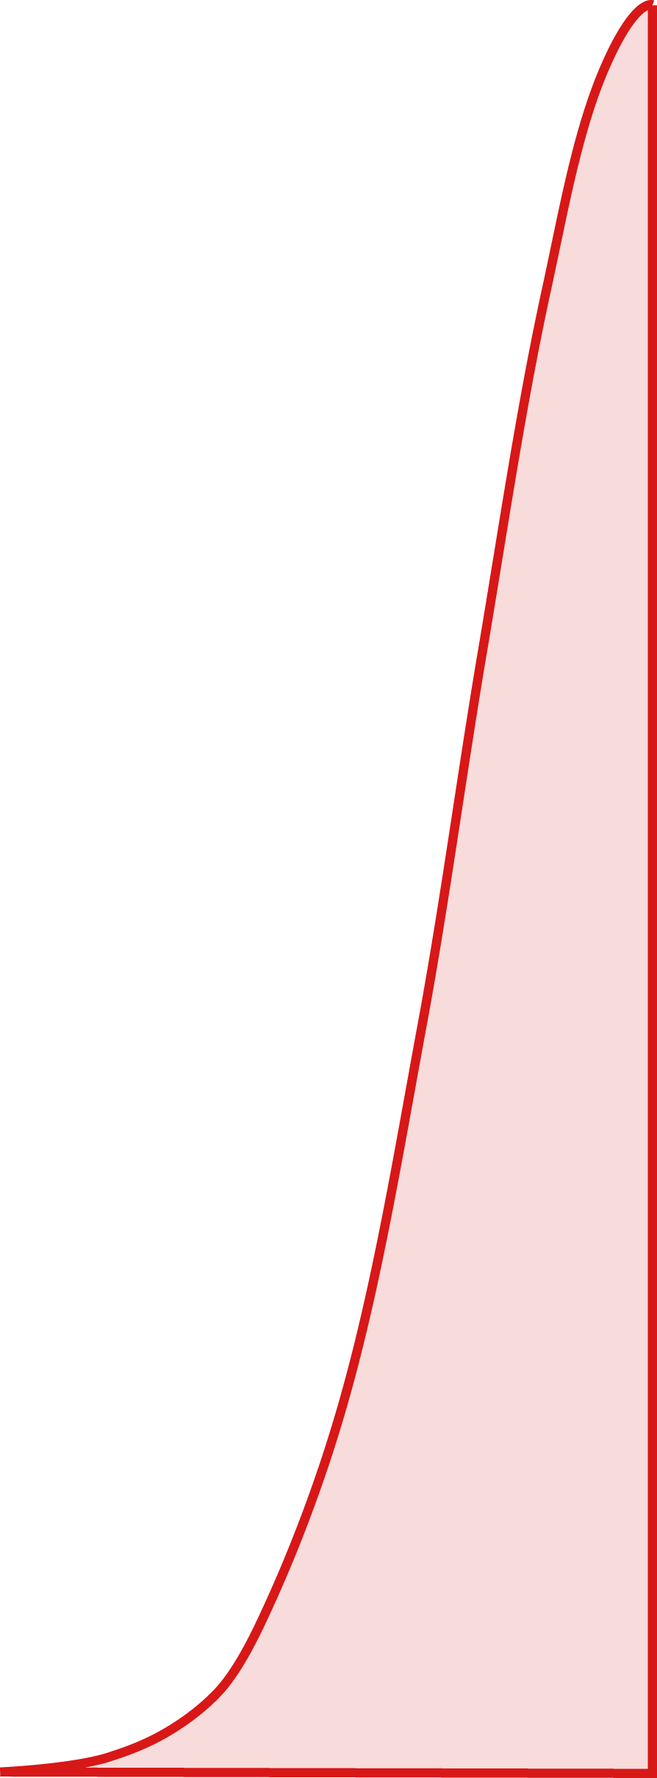
Is Your Data Still Relevant?
5
4
Data¹
3
Current time plane
2
1
Time
[1] Data represents customer rating of a particular product on Amazon (https://nijianmo.github.io/amazon/index.html)
Notes:
You can use some windowing techniques to degrade the values of the old measurements but again the question is how wide that window should be?

Slide 5
Moving Average Estimation: What is a Good Window Length?
Simple Moving Average Estimations (SMAE) are still among the widely used filtering solutions in many fields of research.
SMAE is fast to compute and easy to interpret.
The challenge of systematically selecting an appropriate timescale or window length over which to average measurements persists to this day¹.
This is mainly because in many scenarios the signal and noise characteristics are not available in prior or have an unforeseen dynamics².
Some Applications of Simple Moving Average Filters:
Trend Visualization
(shynkevich, 2014)
Econometrics
(Ellis, 2005)
Communication systems
(luo, 2012)
[1] Nadkarni, Aditya, and S. A. Soman. "Applications of trend-filtering to bulk pmu time-series data for wide-area operator awareness." 2018 Power Systems Computation Conference (PSCC). IEEE, 2018.
[2] Smulko, J. "Methods of trend removal in electrochemical noise data–Overview." Measurement 131 (2019): 569-581.

Slide 6
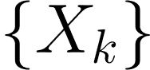
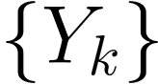
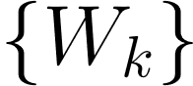
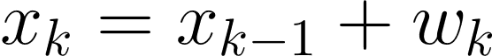
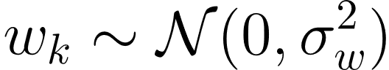
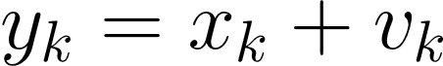
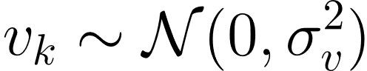
Estimation of Noisy Random Walks
The goal is to estimate the value of a time-varying parameter , based on historical measurements .
Dynamics of the target parameter may be modeled as a random walk stochastic with a white Gaussian process noise , i.e.,
Measurements of the time-varying parameter are themselves assumed to be corrupted by Gaussian white noise, i.e.,

Slide 7
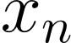
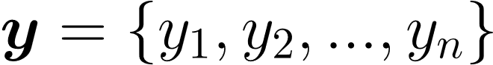
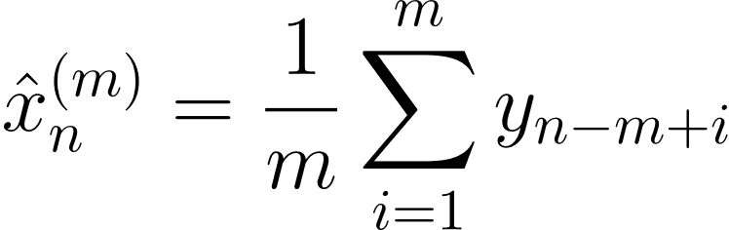
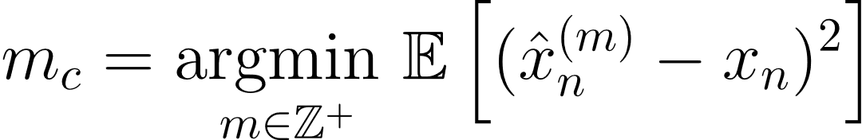
Optimal Simple Moving Average Estimation of Noisy Random Walks
Simple Moving Average Estimation (SMAE) attempts to recover the value of the parameter at the last timestep, , given historical measurements .
The optimal window length is referred to as the characteristic timescale, which is the window length (or timescale) that minimizes the mean-square estimation error, i.e.,

Slide 8
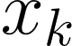
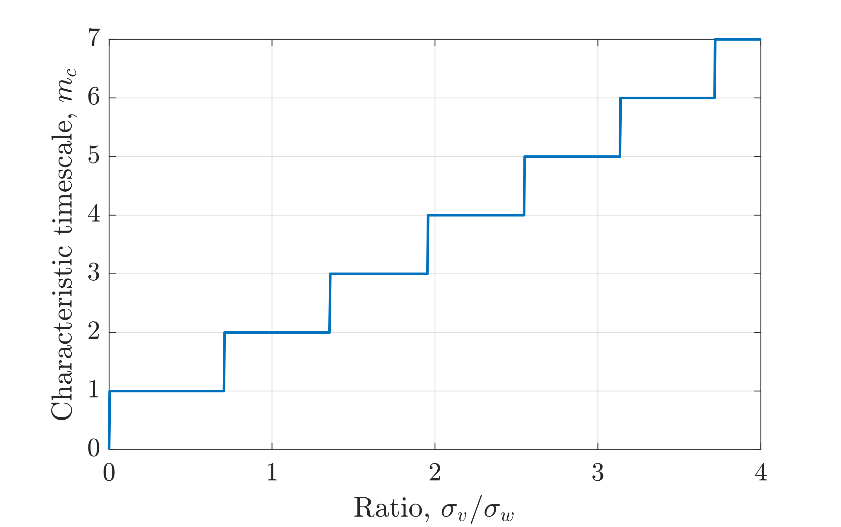
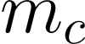
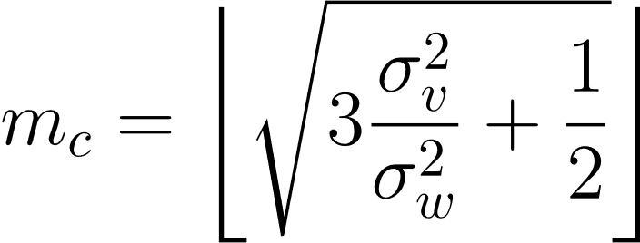
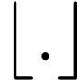
O-SMAE of Noisy Random Walks
Theorem 1: If the drift signal is realized from a random walk process and the measurements are corrupted with white Gaussian noise, then the characteristic timescale is given by:
where denotes rounding to the adjacent integer with the smaller estimation error.

Slide 9
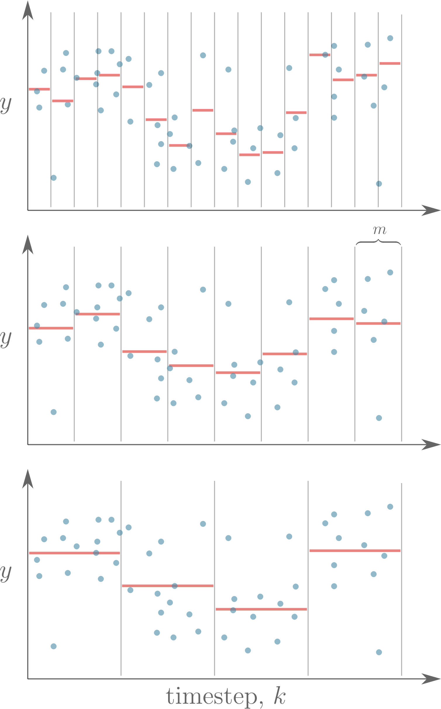
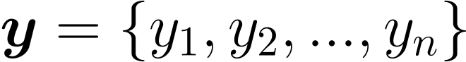
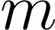
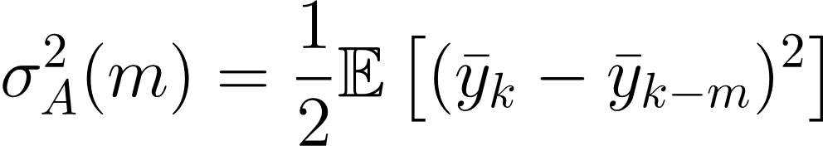
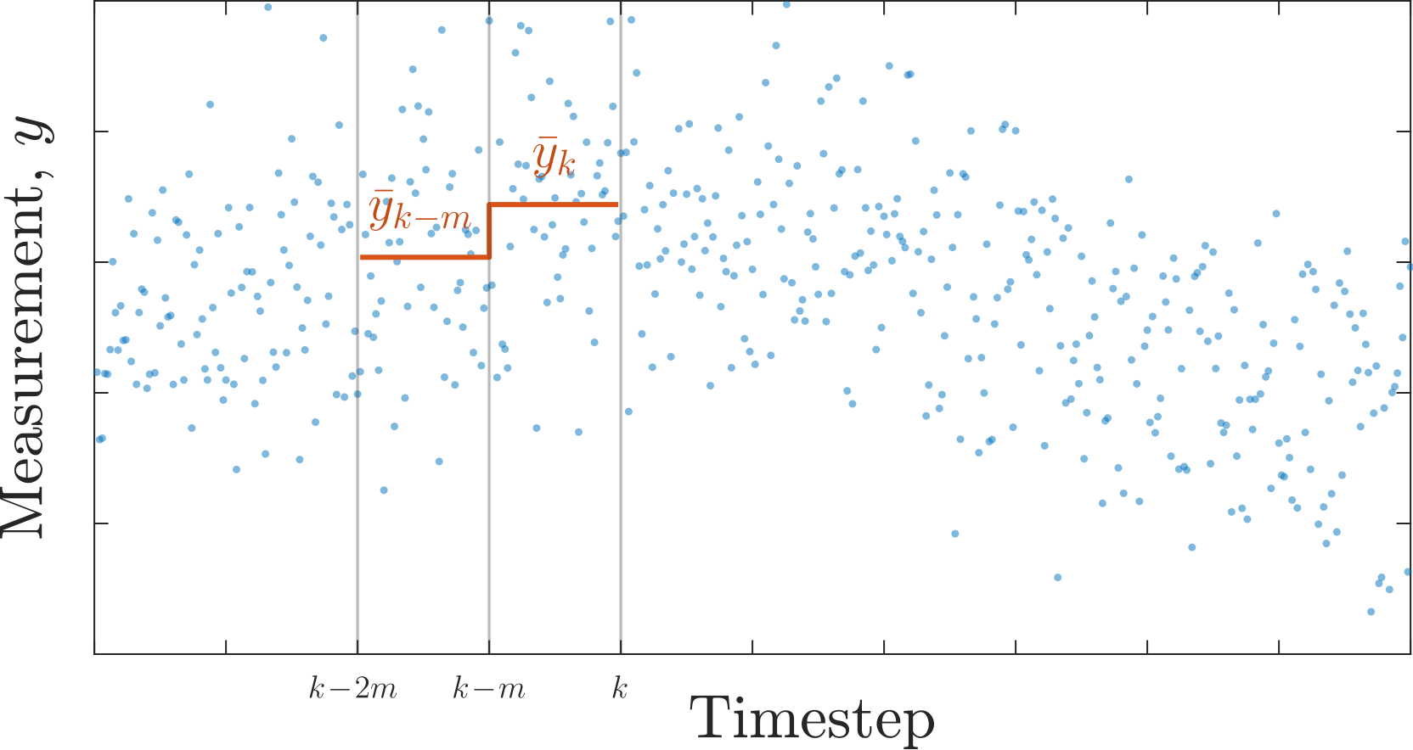
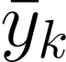
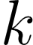
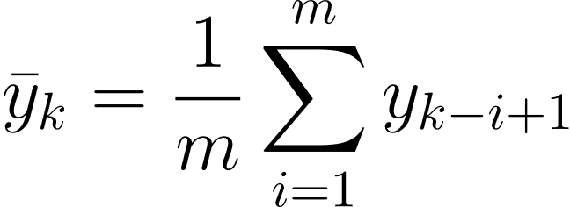
Allan Variance as a Measure of Signal Bias Variation at a Particular Timescale
The non-overlapping Allan Variance, also known as two-sample variance, for a time series is defined as a function of timescale as:
where is the average of measurements in the window of size calculated at the time step :

Slide 10
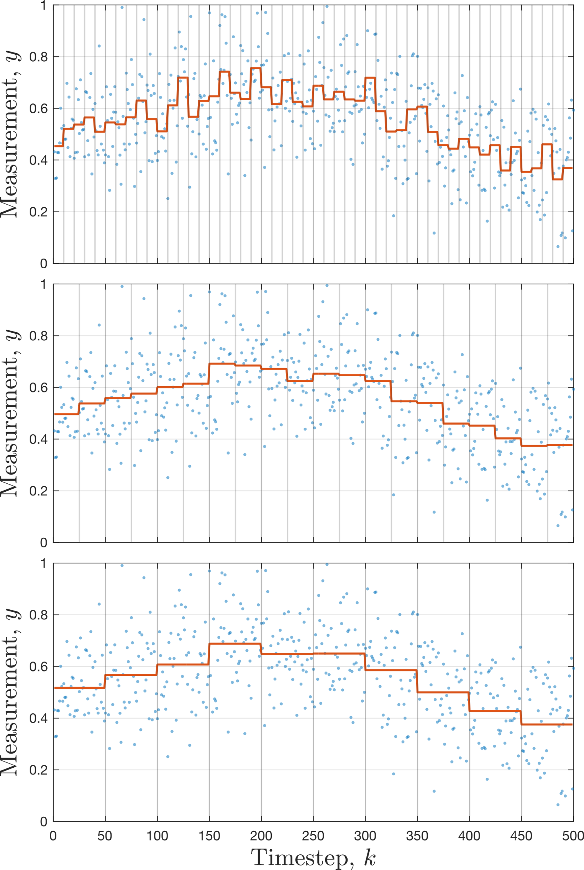
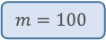
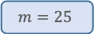
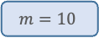
Allan Variance as a Measure of Signal Bias Variation at a Particular Timescale
The non-overlapping Allan Variance, also known as two-sample variance, for a time series is defined as a function of timescale as:
where is the average of measurements in the window of size calculated at the time step :
$$m=10$$
$$m=25$$
$$m=100$$

Slide 11
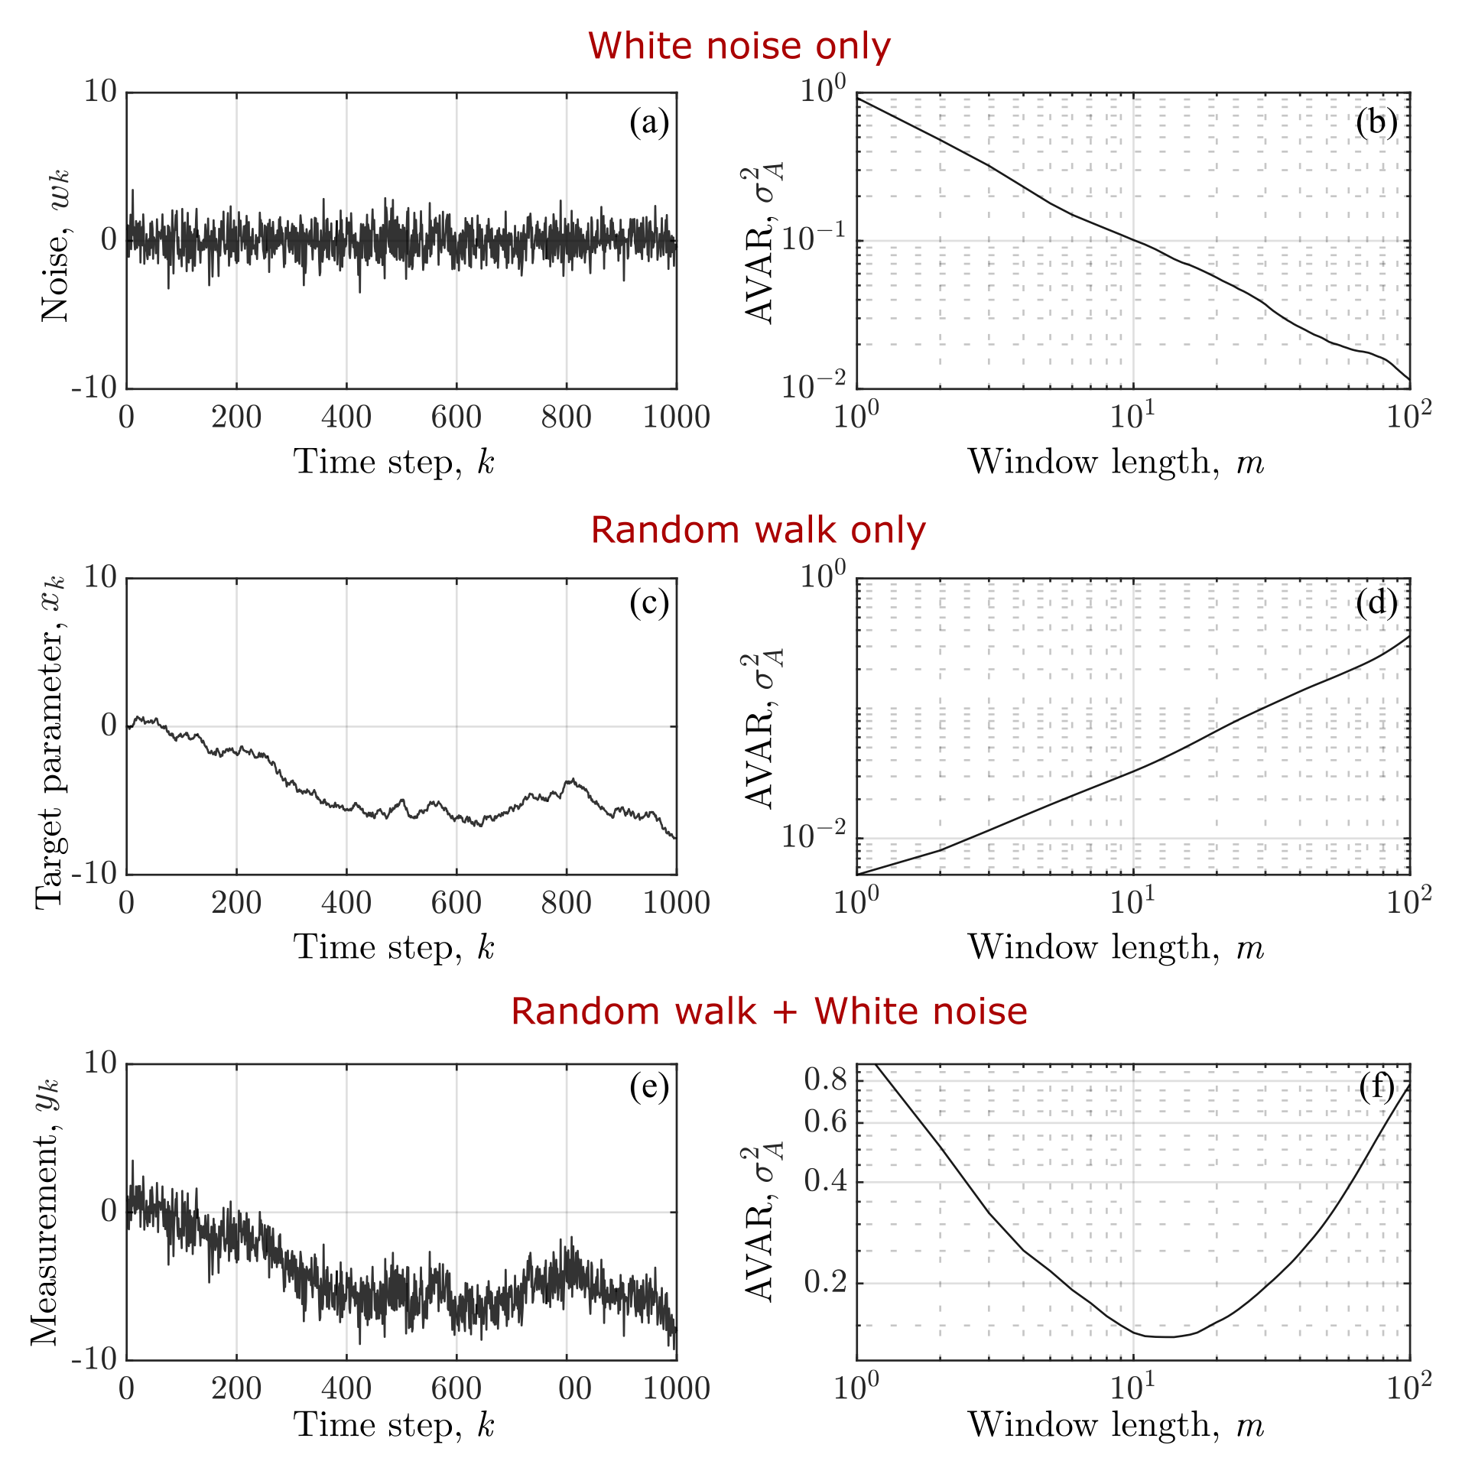
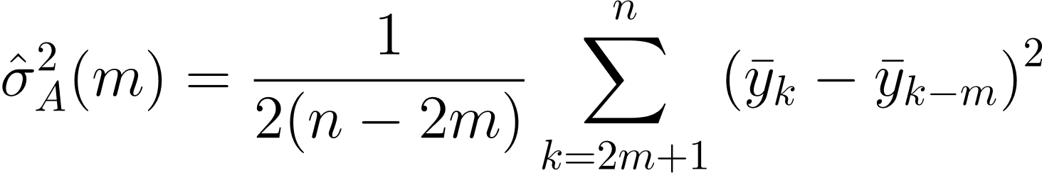
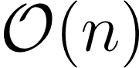
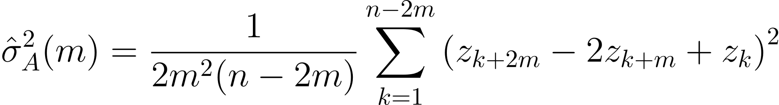
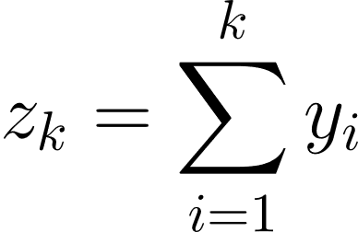
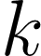
Estimating Allan Variance
Allan Variance can be naively estimated as:
AVAR can be also calculated in as¹:
where is the accumulated signal value at
the time step .
[1] Elfeki, Amro, and Jarbou Bahrawi. "Application of the random walk theory for simulation of flood hazards: Jeddah flood 25 November 2009." International journal of emergency management 13.2 (2017): 169-182.

Slide 12
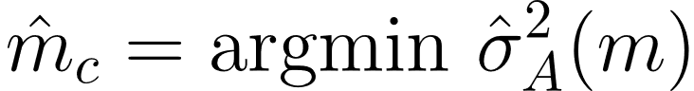
Allan Variance of Noisy Random Walks Yields Characteristic Timescale
Theorem 2: If the drift signal is realized from a random walk process and the measurements are corrupted with white Gaussian noise, then timescale minimizing Allan Variance is an unbiased estimate of the characteristic timescale , i.e.,

Slide 13
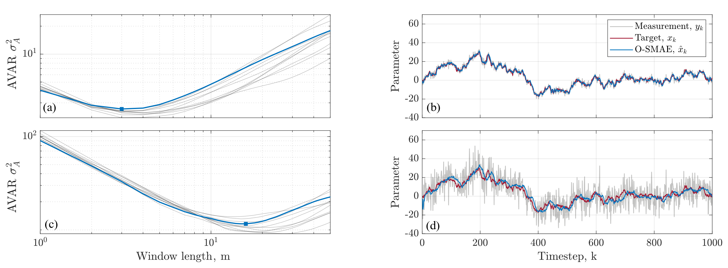
Example of Optimal Simple Moving Average Estimation (O-SMAE) using AVAR

Slide 14
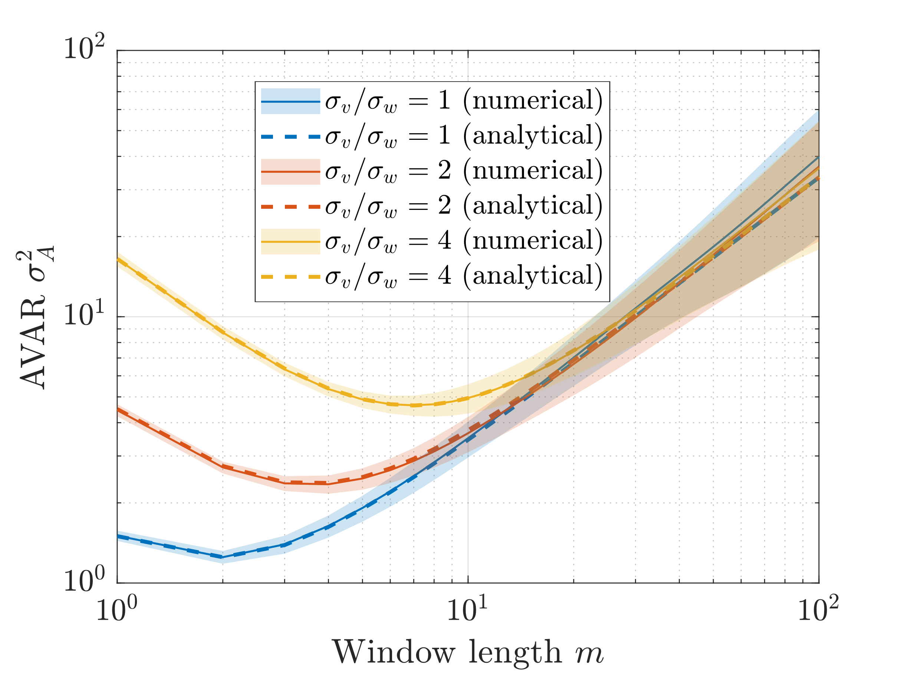
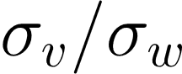
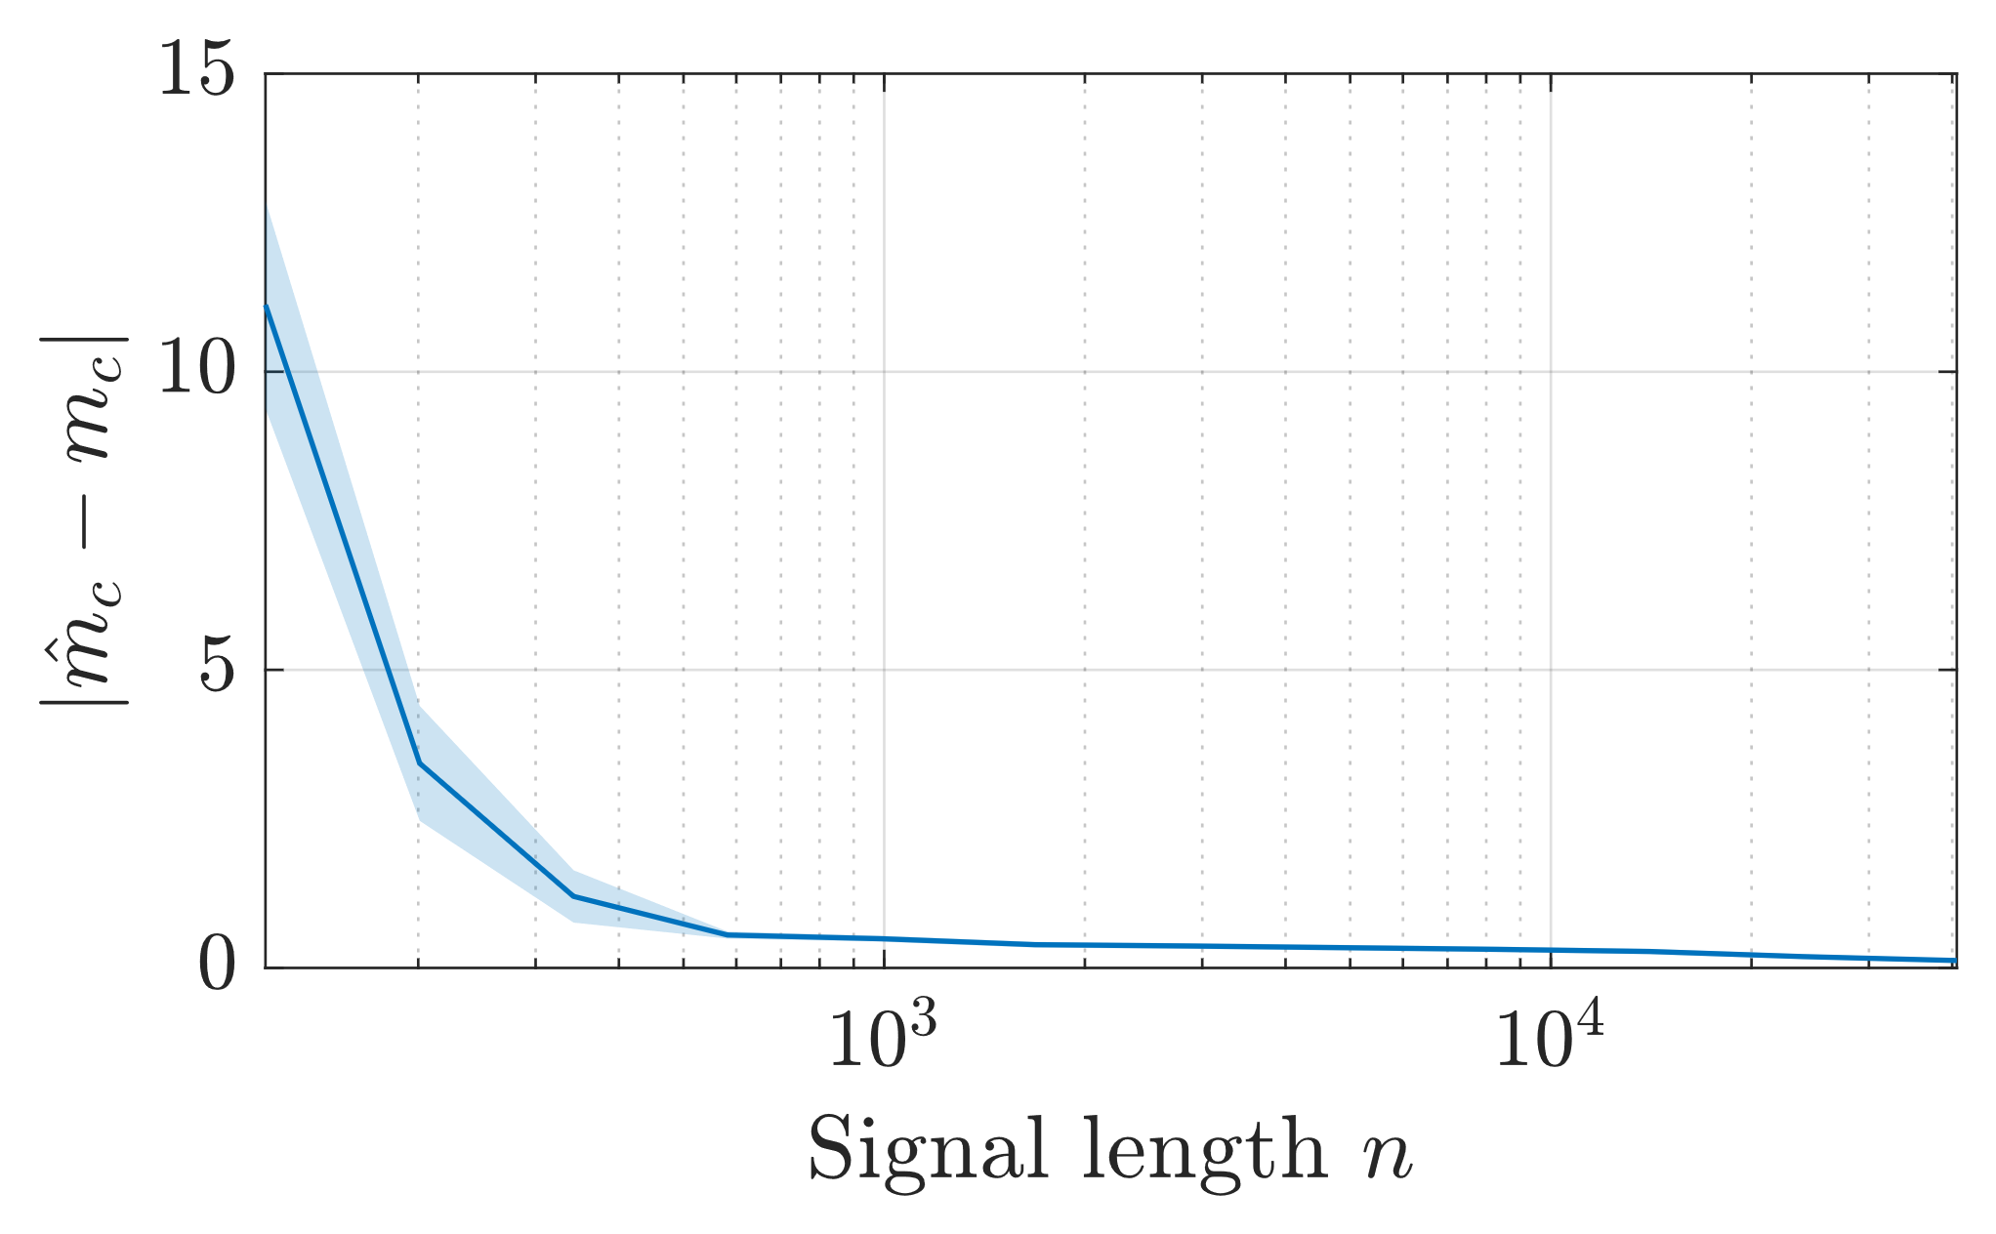
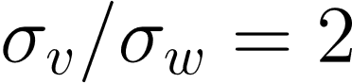
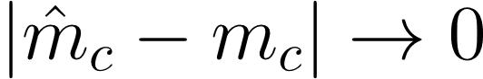
Allan Variance of Noisy Random Walks Yields Characteristic Timescale
Comparing
numerically estimated AVAR using only the measurement signal, vs.
analytically derived AVAR assuming is known,
confirms the accuracy of the AVAR estimation.
While there may be a small error in the size of the optimal window length determined via AVAR, the error as the number of available measurements increases.

Slide 15
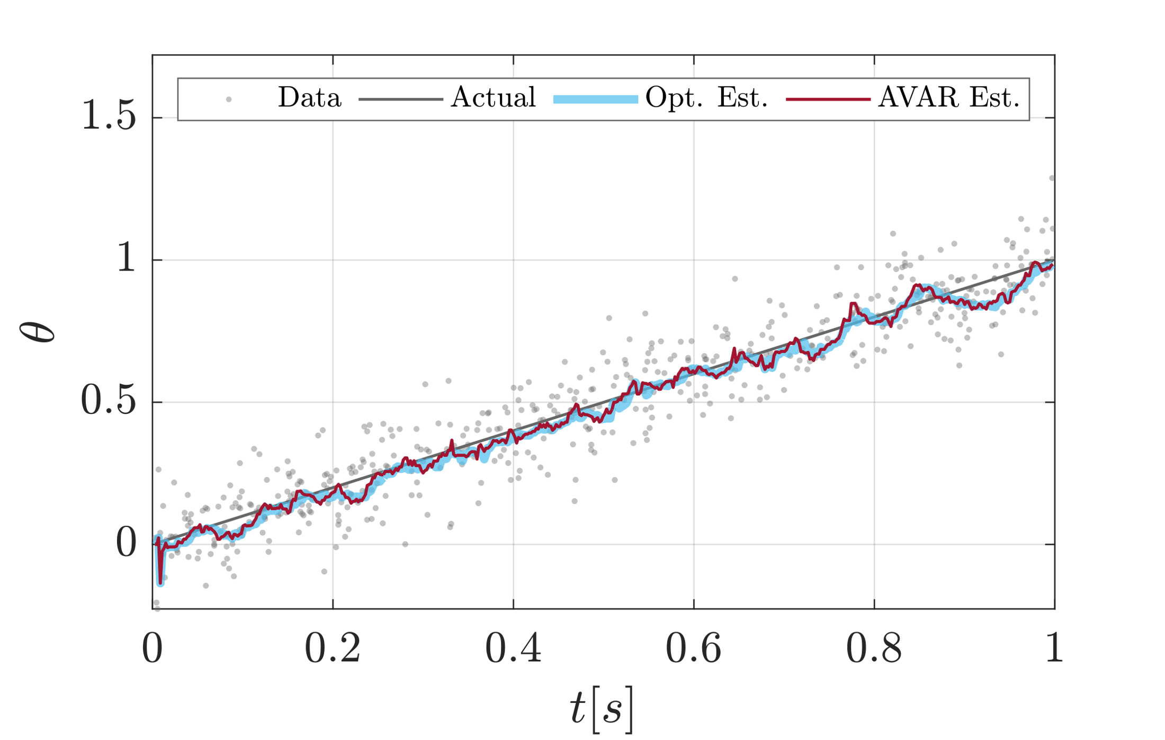
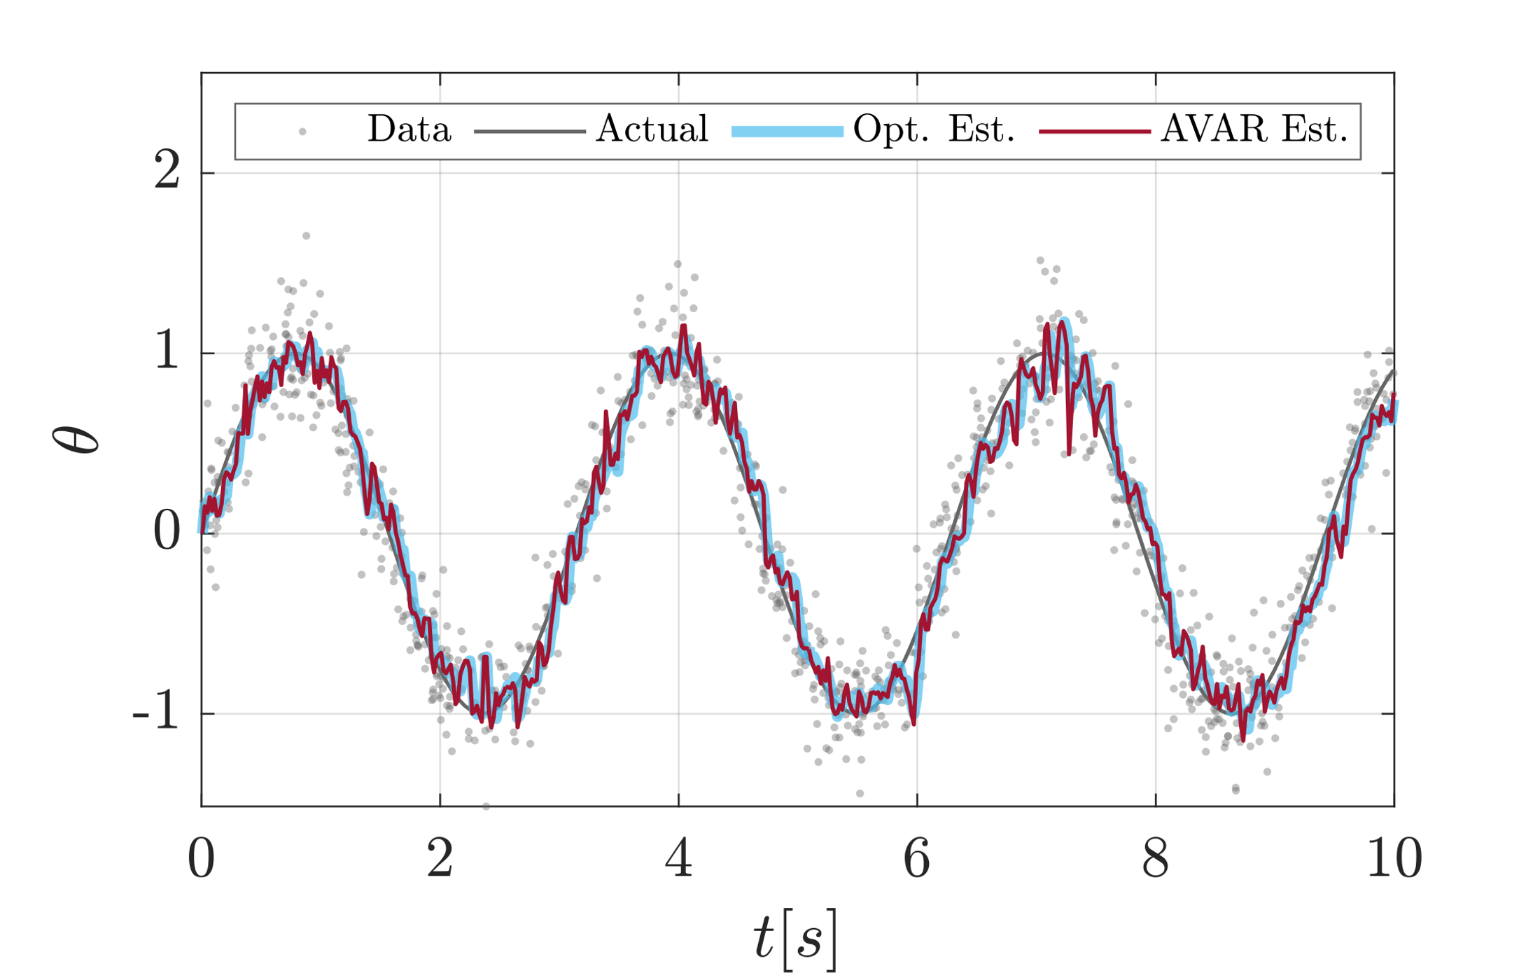
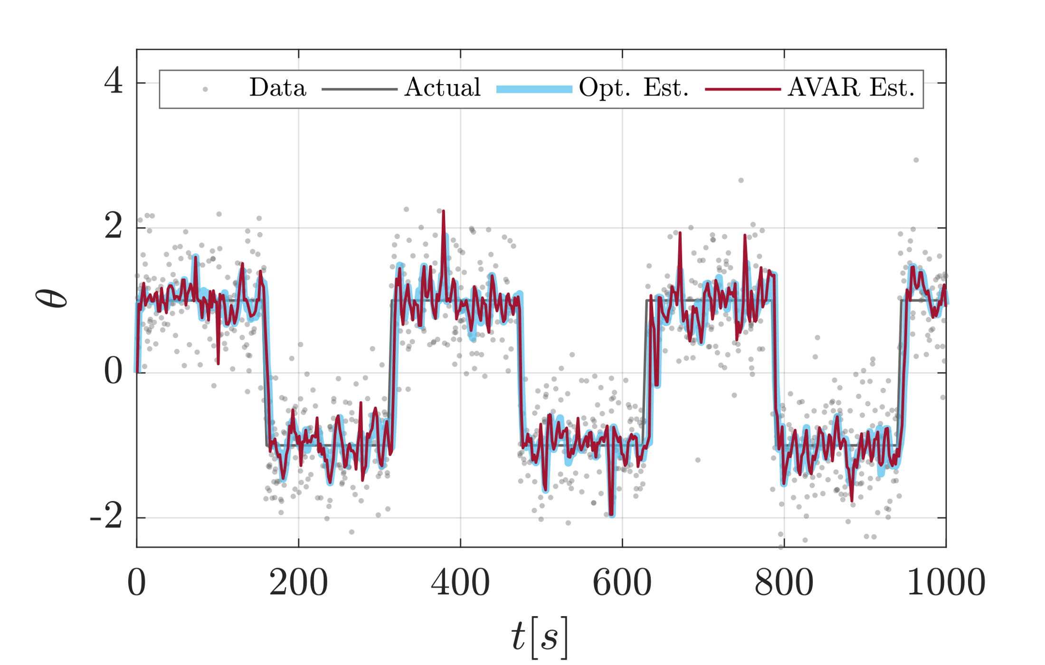
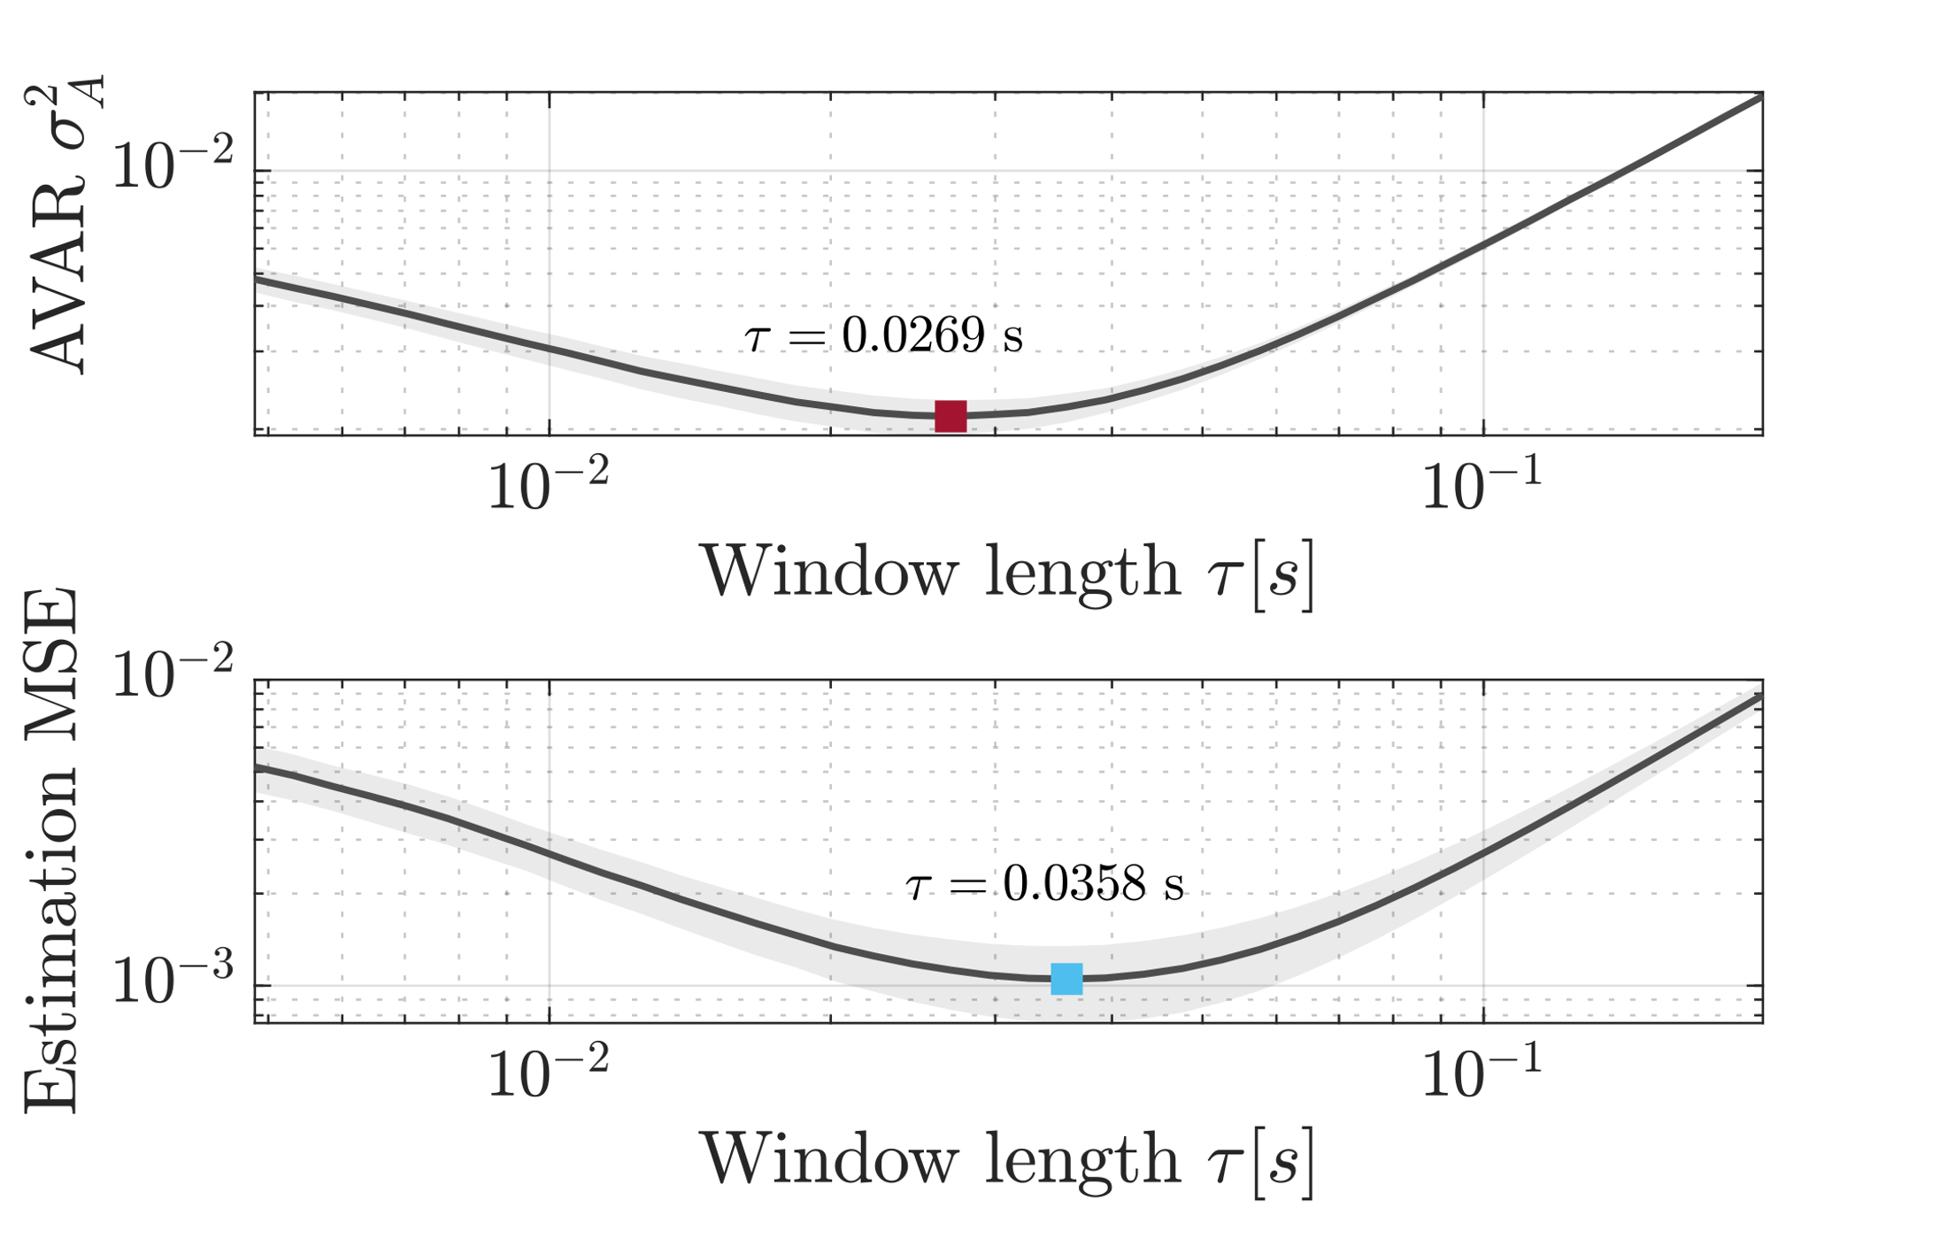
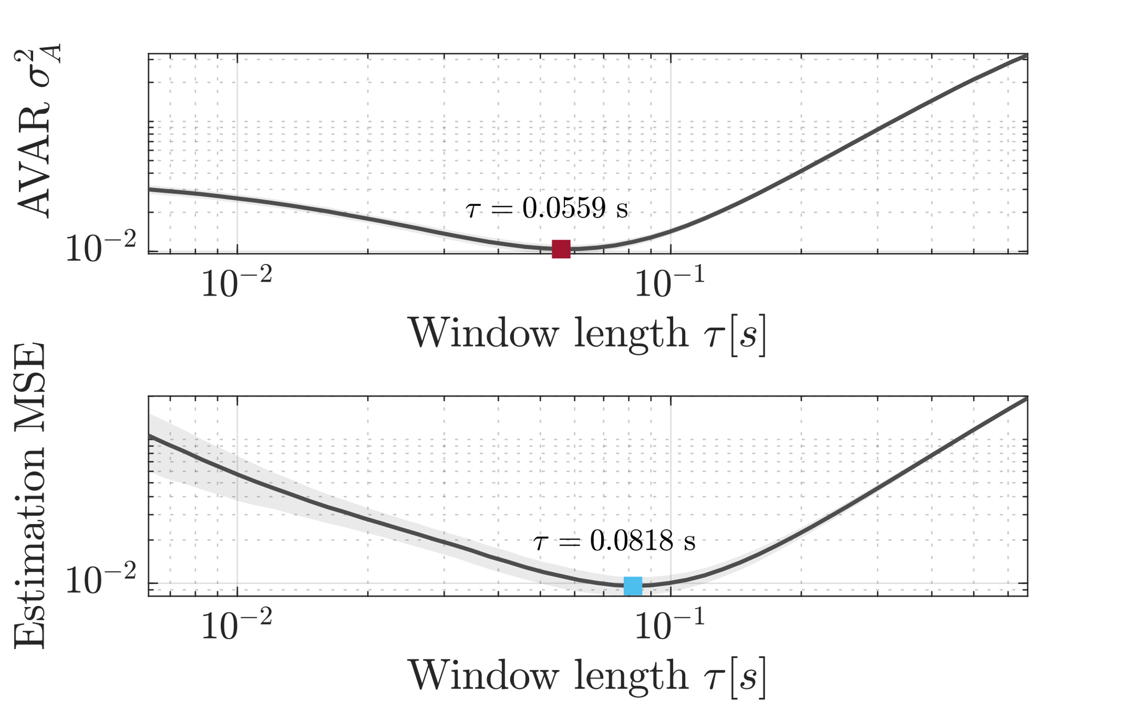

AVAR-Suggested Window Length for Other Signal Types
We have also showed that AVAR-suggested window length yields near-optimal results with non-random walk signals¹.
[1] Haeri, Hossein, Craig E. Beal, and Kshitij Jerath. "Near-optimal moving average estimation at characteristic timescales: An Allan Variance approach." IEEE Control Systems Letters 5.5 (2020): 1531-1536.

Slide 16

Conclusion and Future Work
We can optimally perform moving average estimation of noisy random walks by systematically selecting an Allan variance-informed window length, without the need to rely on heuristics or any prior knowledge of signal and noise characteristics.
In future, we intend to use Dynamic Allan Variance¹ to adaptively estimate the characteristic timescale on-the-fly.
[1] Galleani, Lorenzo, and Patrizia Tavella. "The dynamic Allan variance IV: Characterization of atomic clock anomalies." IEEE Transactions on Ultrasonics, Ferroelectrics, and Frequency Control 62.5 (2015): 791-801.

Slide 17
Optimal Moving Average Estimation of Noisy Random Walks using Allan Variance-informed Window Length Hossein Haeri, Behrad Soleimani, and Kshitij Jerath
American Control Conference (ACC2022) | June 8, 2022 | Atlanta, GA

Slide 18







Optimal Window Length in Simple Moving Average Estimation (SMAE)
To be more specific, we want to solve the problem:
Opening the term inside the expectation operator, we get
Using the fact that , we can write terms and as:

Slide 19






Optimal Window Length in Simple Moving Average Estimation (SMAE)
Thus, we have
To find , we let . We would then have:
Convex for $m>0$

Slide 20




Optimal Window Length in Simple Moving Average Estimation (SMAE)
Simplifying terms, we obtain a closed form linear relationship between window length $m$ and ratio $r$:
The above equation finds the optimal window length in terms of the ratio between random walk process noise and measurement noise variances.
Question: Can we estimate this window length without having any prior knowledge about the signal/noise parameters?
, where

